Slide 1
Product Specifications
Teaching materials to accompany:
Product Design and Development
Chapter 6
Karl T. Ulrich and Steven D. Eppinger
5th Edition, Irwin McGraw-Hill, 2012.

Slide 2
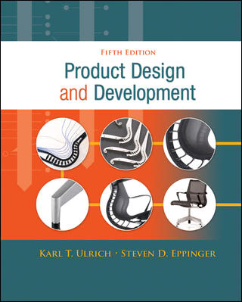
Product Design and Development
Karl T. Ulrich and Steven D. Eppinger
5th edition, Irwin McGraw-Hill, 2012.
Chapter Table of Contents:
Introduction
Development Processes and Organizations
Opportunity Identification
Product Planning
Identifying Customer Needs
Product Specifications
Concept Generation
Concept Selection
Concept Testing
Product Architecture
Industrial Design
Design for Environment
Design for Manufacturing
Prototyping
Robust Design
Patents and Intellectual Property
Product Development Economics
Managing Projects

Slide 3
Concept Development Process
Mission
Statement
Identify
Customer
Needs
Establish
Target
Specifications
Generate
Product
Concepts
Select
Product
Concept(s)
Test
Product
Concept(s)
Set
Final
Specifications
Plan
Downstream
Development
Development
Plan
Perform Economic Analysis
Benchmark Competitive Products
Build and Test Models and Prototypes
Target Specs
Based on customer needs and benchmarking
Final Specs
Based on selected concept, feasibility, models, testing, and trade-offs

Slide 4
Outline
Nature of specifications
Spec vs. specs.
Target vs. final specs.
Process for setting target specs
Process for setting final specs

Slide 5
Spec vs. Specs
A spec consists of a metric, a unit, and a value
Specs has a set of specs.

Slide 6
Target vs. Final Specs
Target specs: the hope and aspiration of the design (ideal and marginal)
Refined specs: trade-offs among different desired characteristics.
  Intermediate specs
Final specs
  It is in the project’s contract book

Slide 7
Nature of Specifications
The reference point for functionality design and quality planning
A product assembly usually requires a hierarchy of specs, for the final product and each of its components

Slide 8
The Product Specs Process
Set Target Specifications
  Based on customer needs and benchmarks
  Develop metrics for each need
  Set ideal and acceptable values
Refine Specifications
  Based on selected concept and feasibility testing
  Technical and economic modeling
  Trade-offs are critical
Reflect on the Results and the Process
  Critical for ongoing improvement

Slide 9
Procedure for establishing target specifications
Identify a list of metrics and measurement units that sufficiently address the needs
Collect the competitive benchmarking information
Set ideal and marginally acceptable target values for each metric (using at least, at most, between, exactly, etc.)
Reflect on the results and the process

Slide 10
Process for setting the final specifications
Develop technical models to assess technical feasibility. The input is design variable and the output is a measurement using a metric.
Develop a cost model of the product.
Refine the specifications, making tradeoffs, where necessary to form a competitive map.
“Flow down” the final overall specs to specs for each subsystem (component and part).
Reflect on the results to see
  Whether the product is a winner, and/or
  How much uncertainty there is in the technical and cost model, or
  Whether there is a need to develop a better technical model.

Slide 11
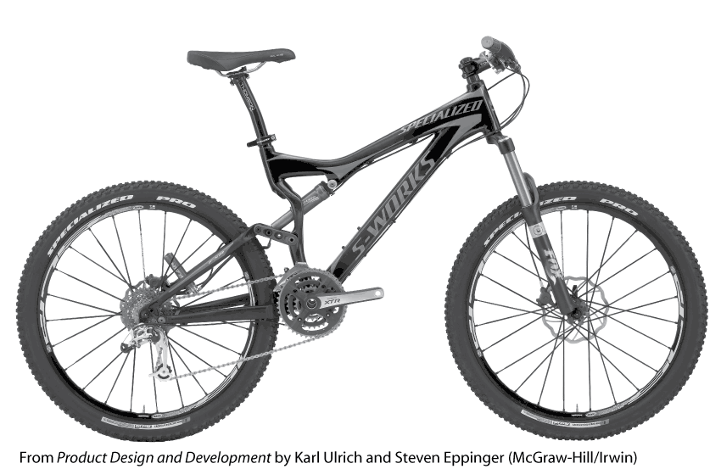

Slide 12
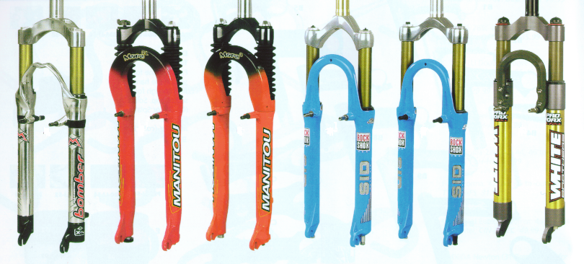
Product Specifications Example:
Mountain Bike Suspension Fork

Slide 13
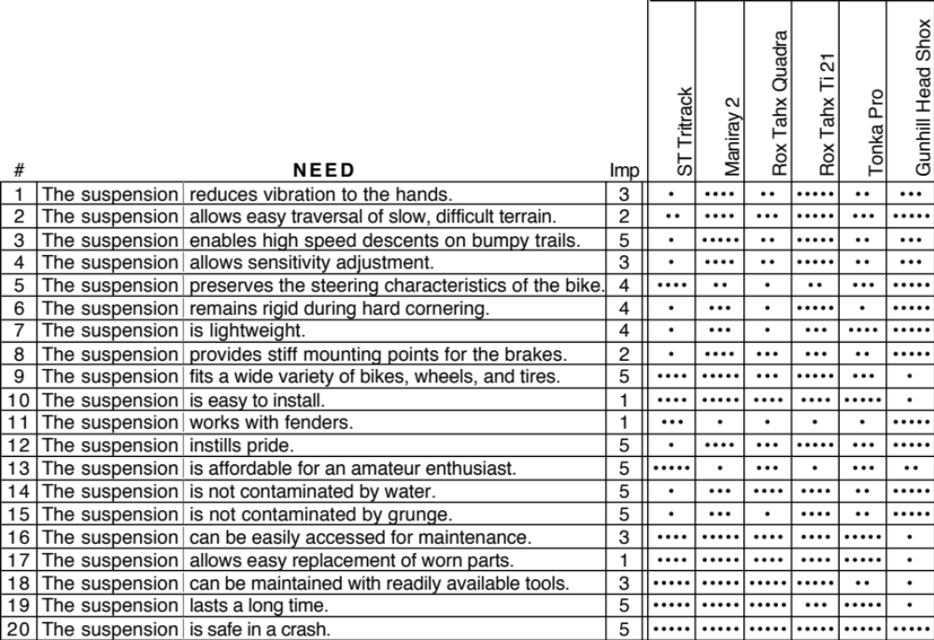
Start with the Customer Needs

Slide 14

Metrics Exercise:
Ball Point Pen
Customer Need:
The pen writes smoothly.

Slide 15
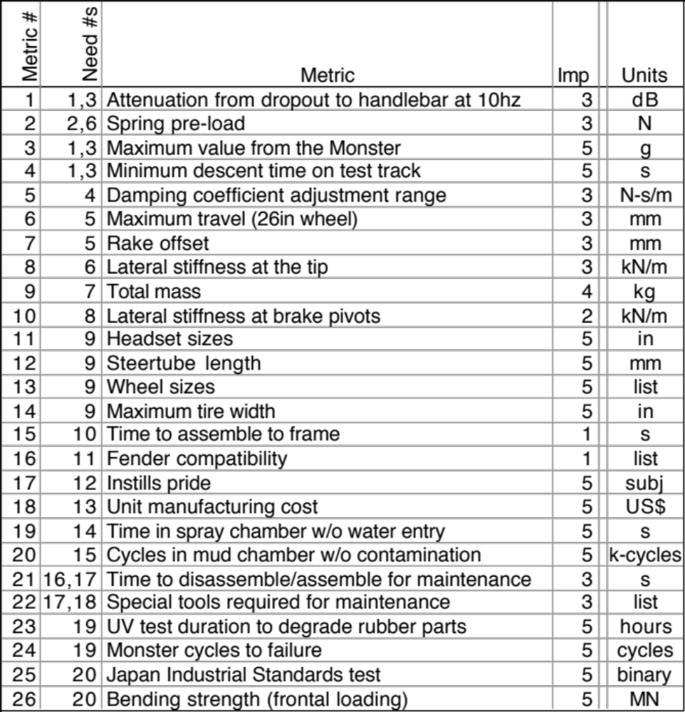
Establish Metrics and Units

Slide 16
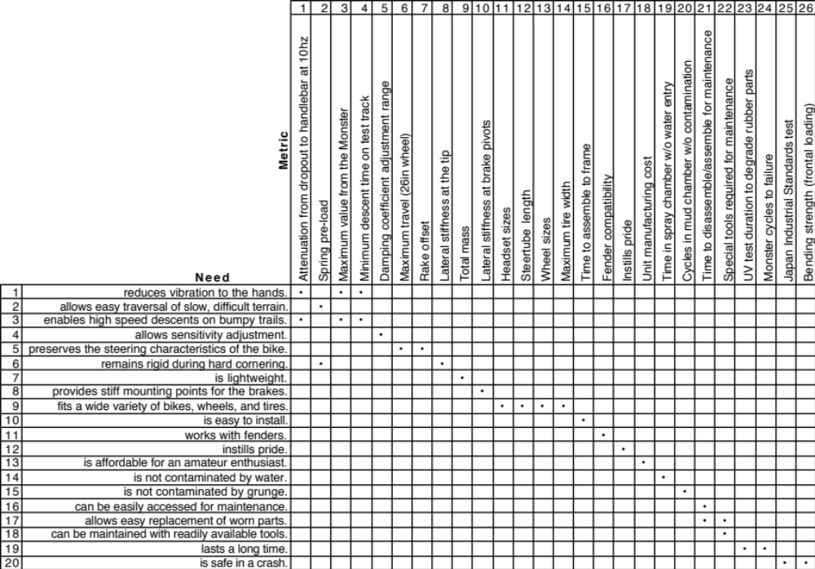
Link Metrics to Needs

Slide 17
Benchmark on Customer Needs

Slide 18
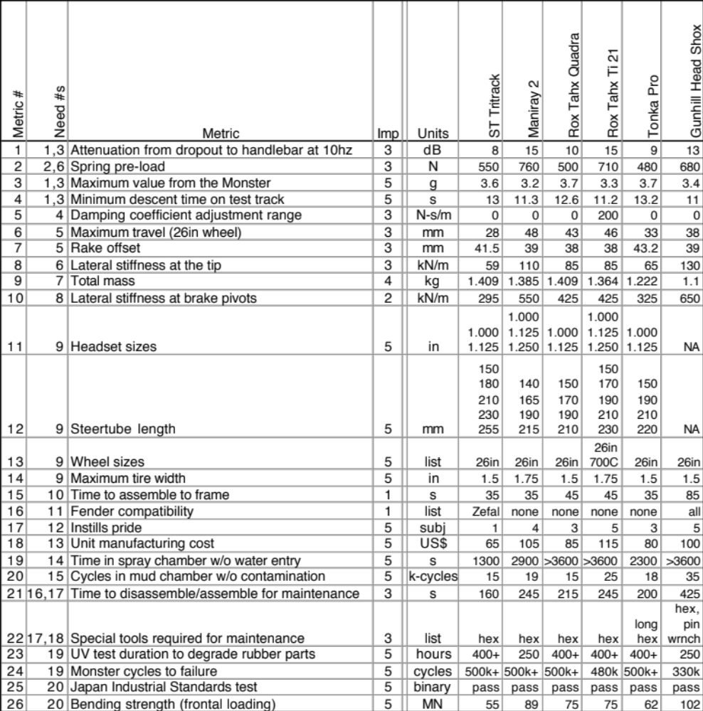
Benchmark on Metrics

Slide 19
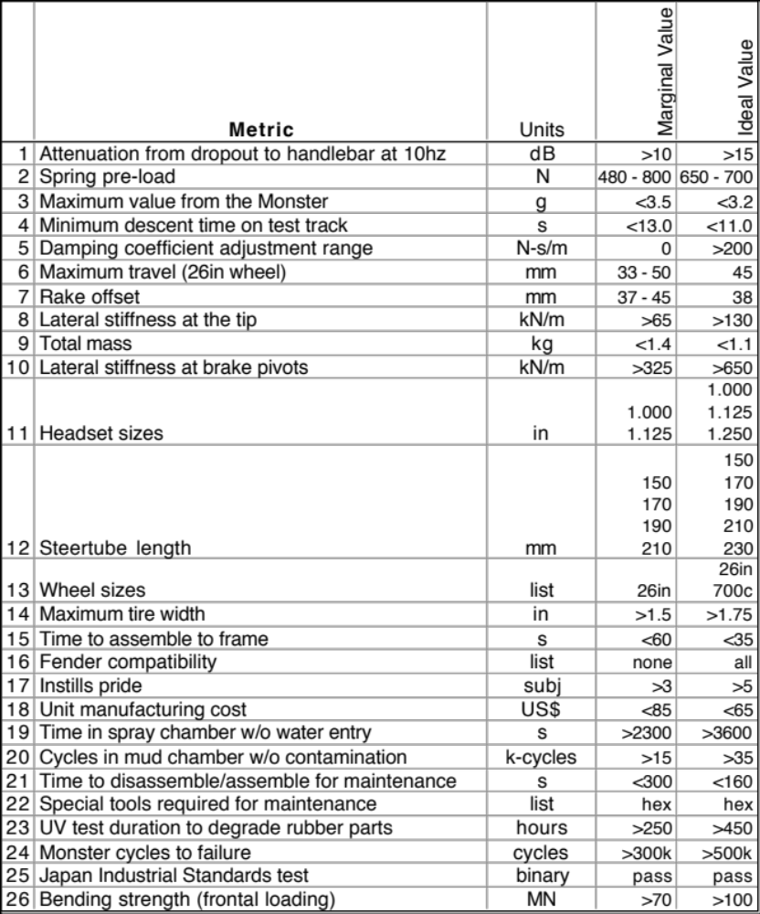
Assign Marginal and Ideal Values

Slide 20
Concept Development Process
Mission
Statement
Identify
Customer
Needs
Establish
Target
Specifications
Generate
Product
Concepts
Select
Product
Concept(s)
Test
Product
Concept(s)
Set
Final
Specifications
Plan
Downstream
Development
Development
Plan
Perform Economic Analysis
Benchmark Competitive Products
Build and Test Models and Prototypes
Target Specs
Based on customer needs and benchmarking
Final Specs
Based on selected concept, feasibility, models, testing, and trade-offs

Slide 21
Perceptual Mapping Exercise
Opportunity?
KitKat
Crunch
Nestlé
Crunch
Hershey’s
w/ Almonds
Hershey’s
Milk Chocolate
Chocolate

Slide 22
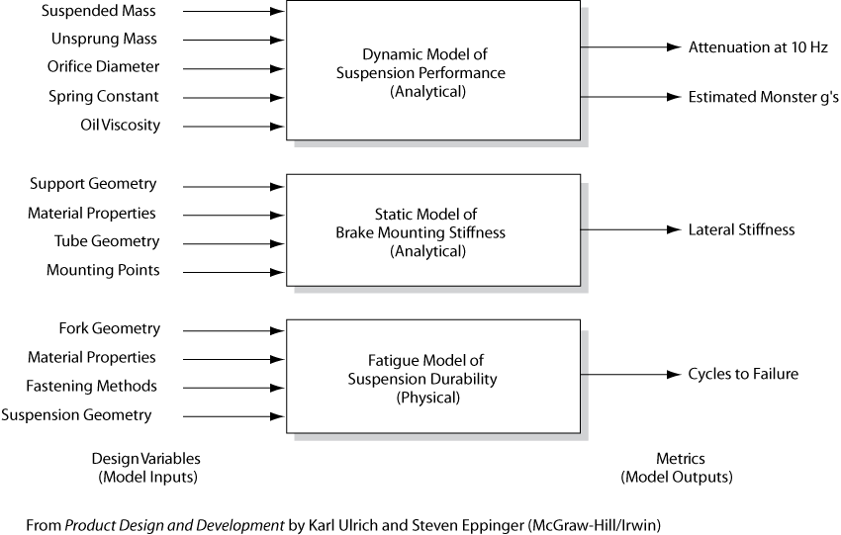

Slide 23
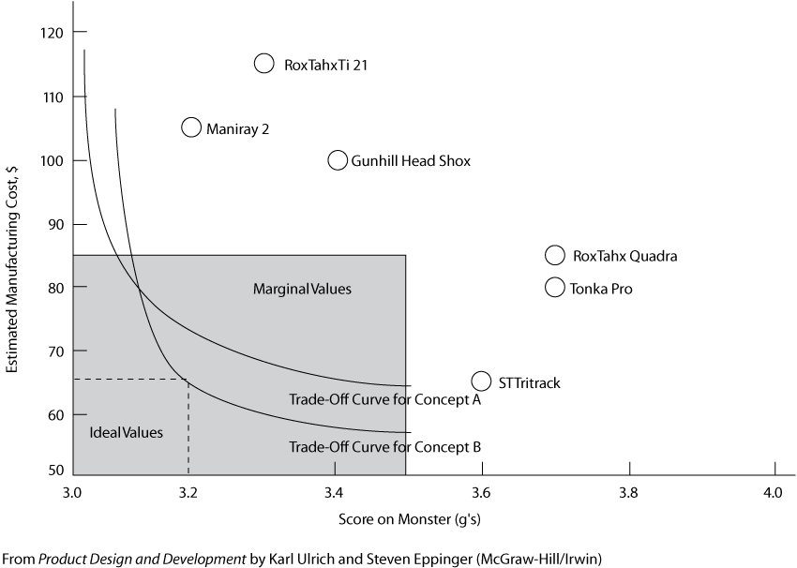

Slide 24
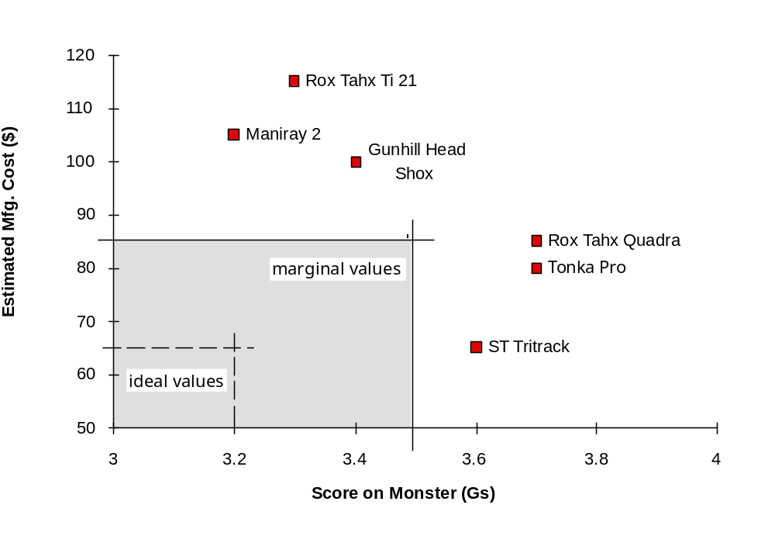
Specification Trade-offs
Trade-off Curves
for Three Concepts
Estimated Manufacturing Cost ($)
Score on Monster (Gs)

Slide 25
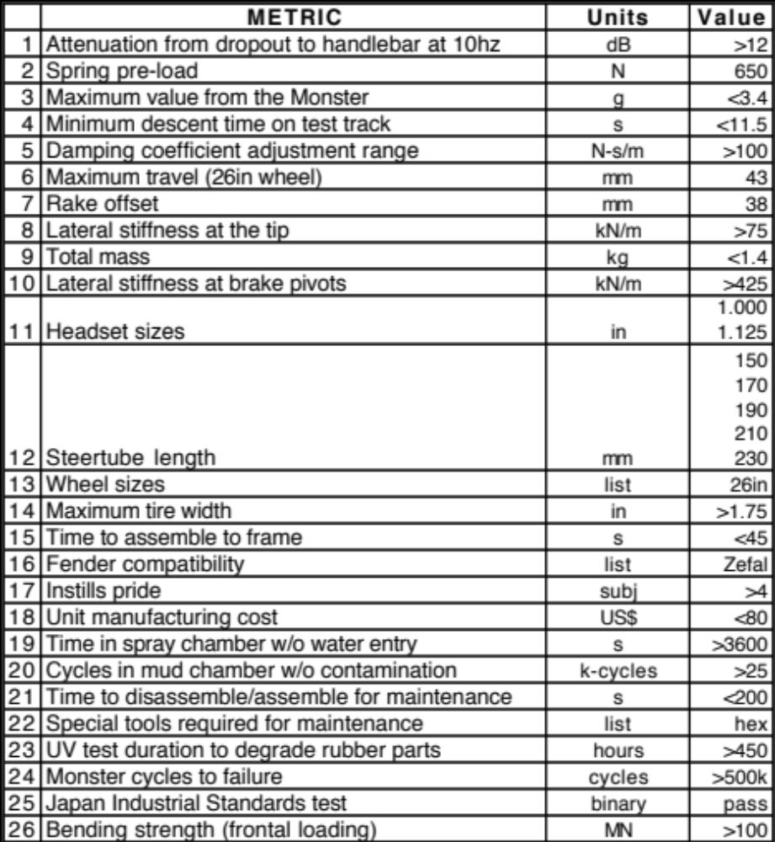
Set Final Specifications

Slide 26
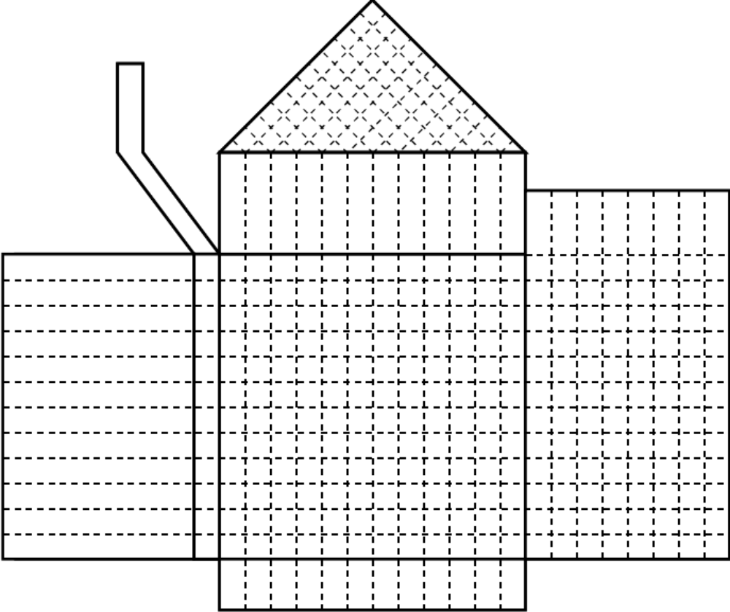
Quality Function Deployment
(House of Quality)
technical
correlations
relative
importance
engineering
metrics
customer
needs
benchmarking
on needs
relationships between
customer needs and
engineering metrics
target and final specs

Slide 27
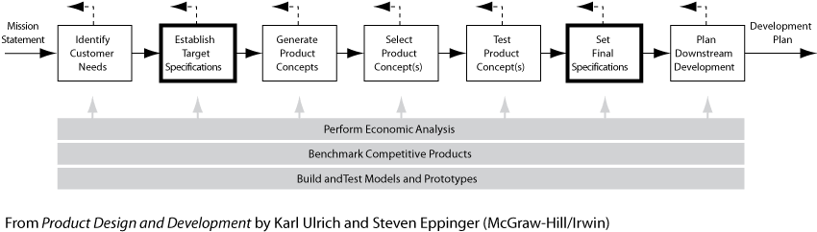

Slide 28

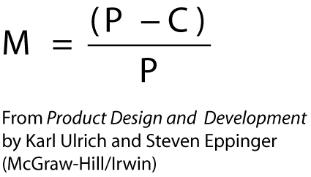
Profit margin
Where:
M: profit margin
P: price
C: cost

Slide 29
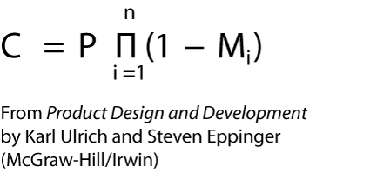
Target Cost
Where:
C = target cost
P = price to the end user
Mi = the margin at the ith stage.

Slide 30
Mark up
Markup = P/C - 1
Where:
P: price
C: cost

Slide 31
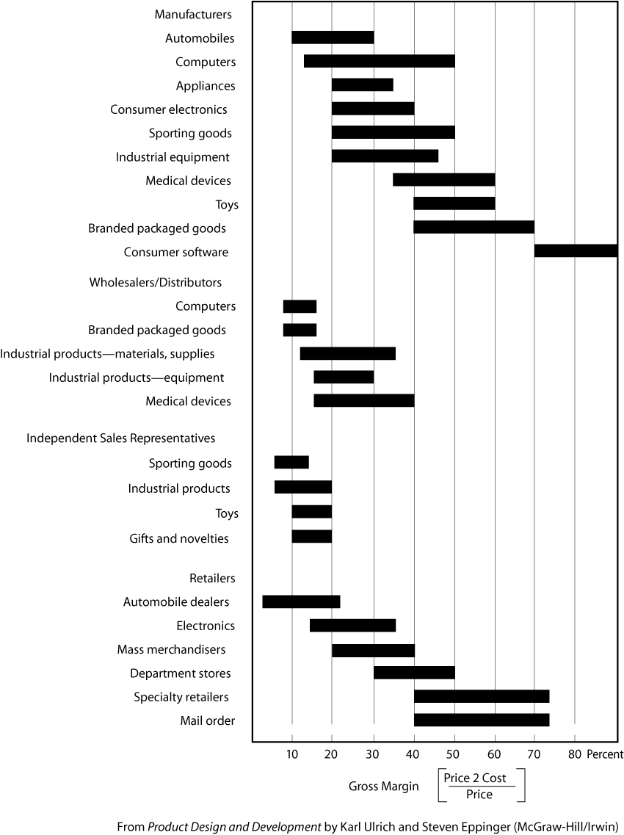

Slide 32
Chapter 6 HW
Metric Exercise: Ball Point Pen
Identify five possible metrics and the unit of measure for a customer need as stated below:
The pen writes smoothly.

